Slide 1

Notes:
Hello. I am Shin Hong from KAIST.
Now I am presenting my research on **Automated Testing of Concurrent Programs**,
**especially on how I utilize coverage metrics to achieve effective and efficient testing of concurrent programs.

Slide 2


Slide 3



Slide 4
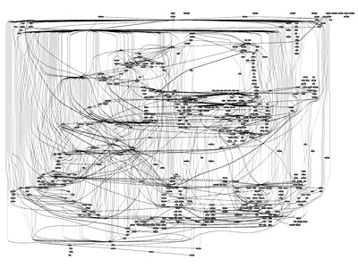
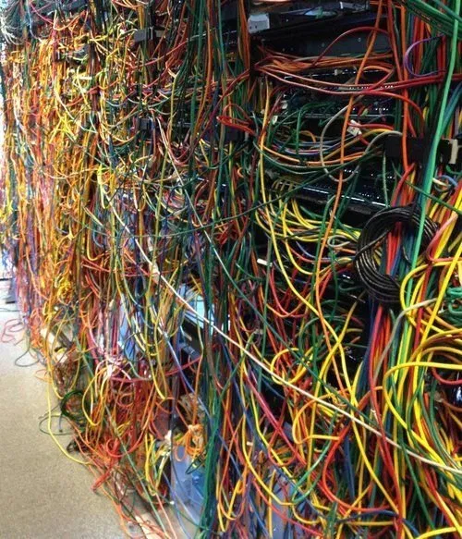

Slide 5

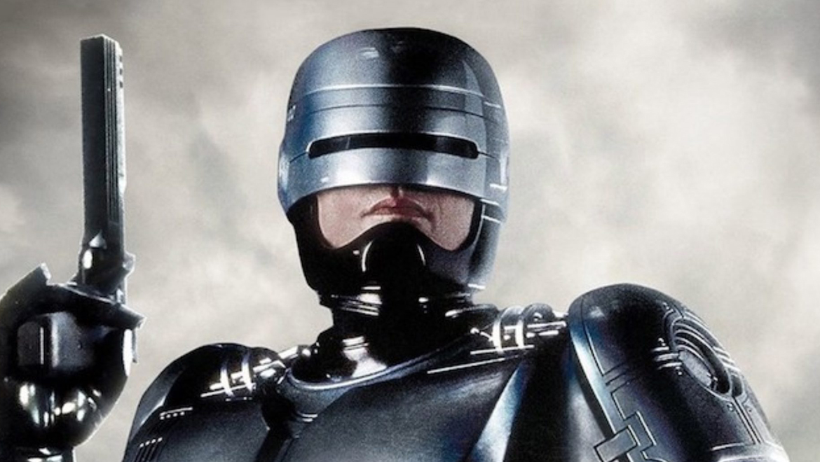
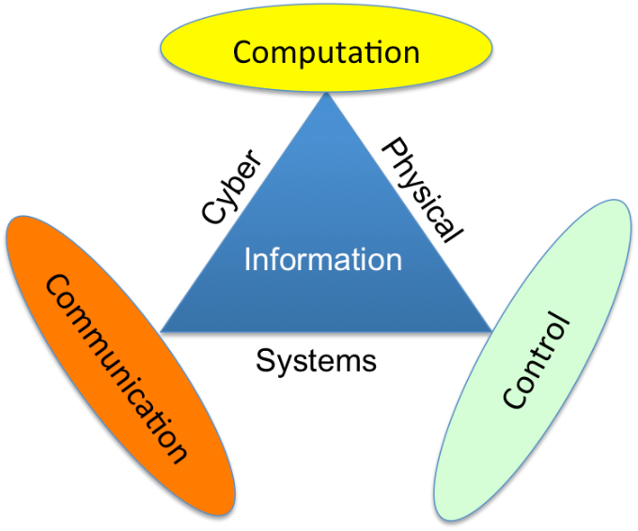
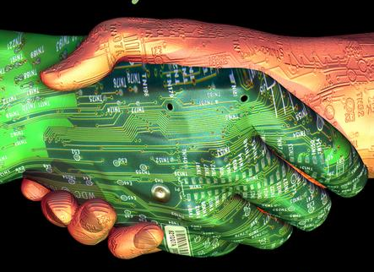
Cyber-Physical System

Slide 6
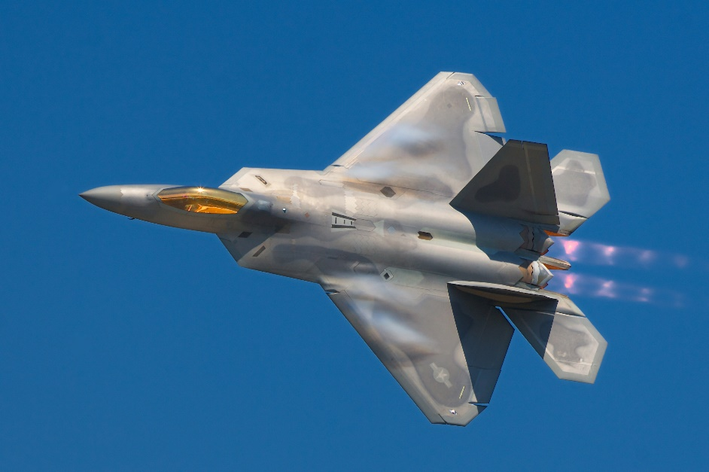
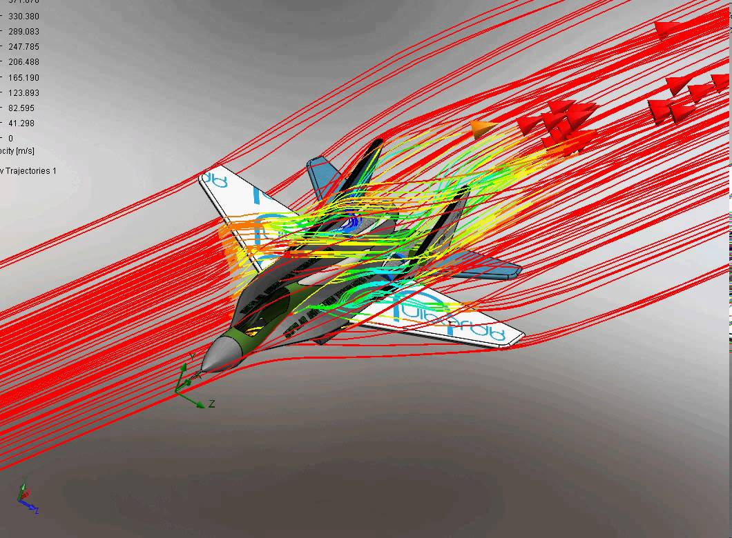
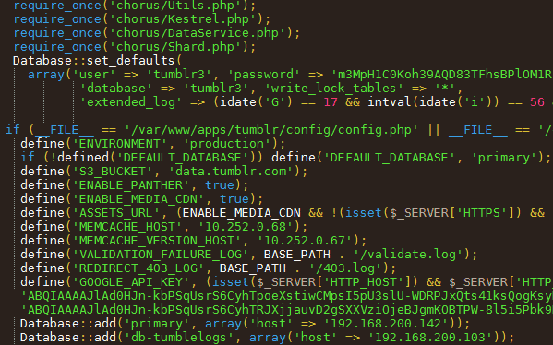

Slide 7
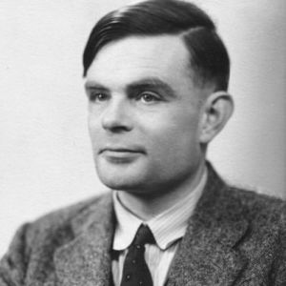
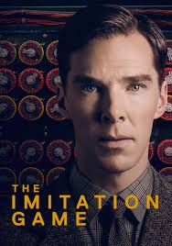
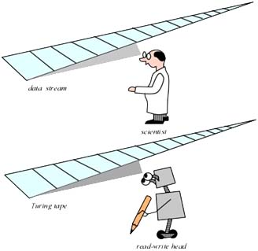
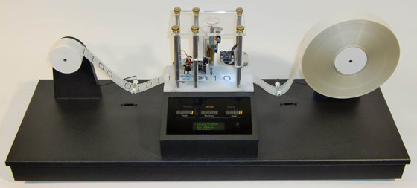

Slide 8
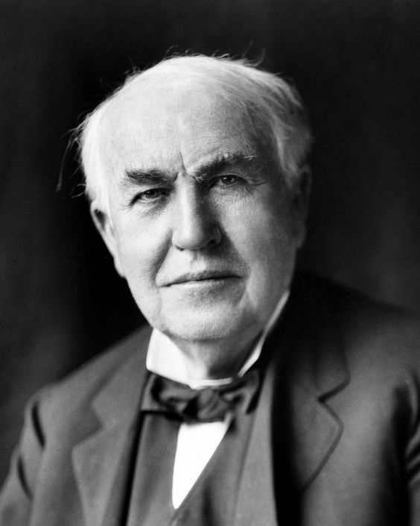
Debug verb
to look for and remove the faults in a computer program
- OALD
"I did find a 'bug' […] The inspect appears to find conditions for its existence in all call apparatus of Telephones."
not very noticeable
not obvious
possible to kill
"'Bug' […] show themselves, and months of anxious watching, study, and labor are requisite before commercial success—or failure—is certainly reached."
critical
complicated
not manageable
Thomas Edison (1847—1931)
Notes:
Living creature.
This naming is very interesting, and it makes sense in two very different view points.
Debug = make "bugs" disappear
Finding out a mistake that is by myself. They are mostly in a blind-spot of developers' mind.
They are like a ghost. So developers feel like it’s a kind of unidentified, fearful creature.

Slide 9
Security
Security is freedom from unwanted coercive change from external forces [wikipedia]
referents: person, society, ecosystem, environment
aspects
absence of harms
presence of an essential good
resilience against potential damage
secrecy
containment

Slide 10
Security Threats by Software
Software is mostly invisible
Software is mostly unprovable
Software is unmanageable when it works out of order
Software is perfectly subject to its user

Slide 11
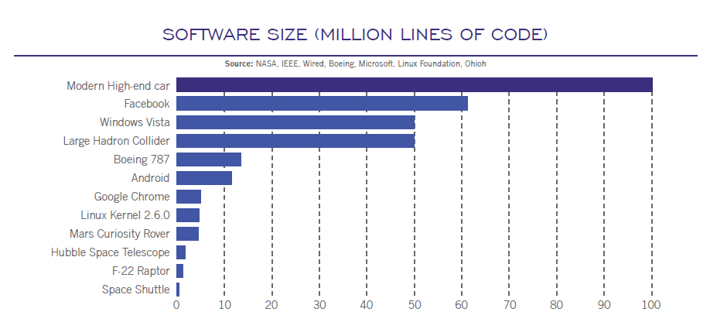
http://blogs.blackberry.com/2016/12/ces-2017-holistic-security-for-the-software-defined-car/

Slide 12
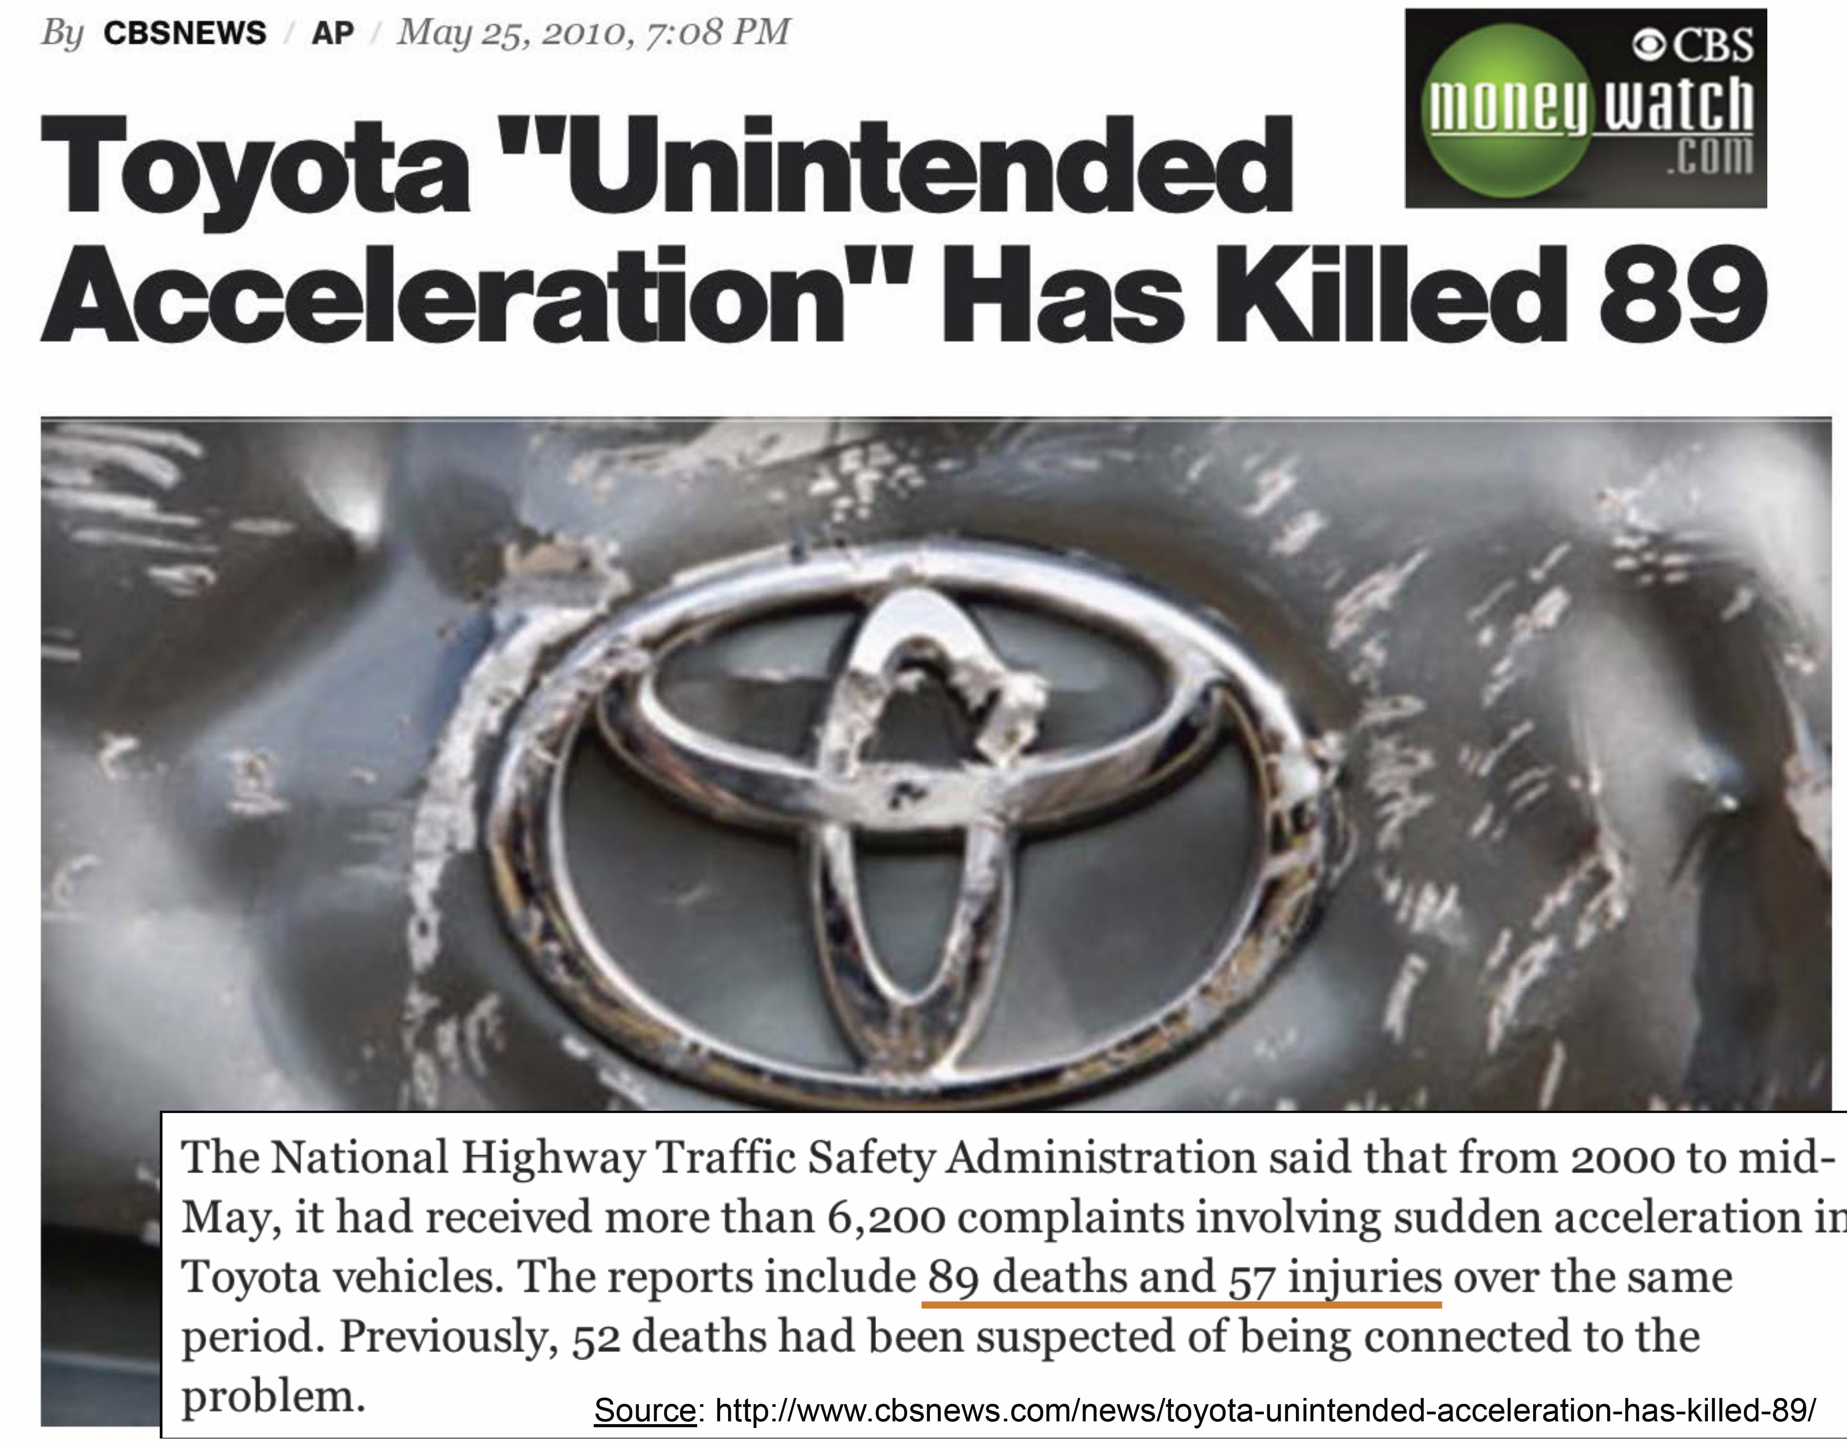
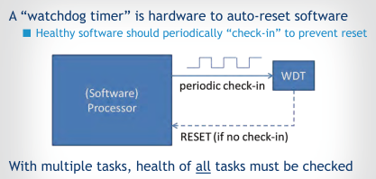
P. Koopman: A Case Study of Toyota Unintended Acceleration and Software Safety, 2014
M. Barr: Killer Apps-Embedded Software's Greatest Hit Jobs, 2014
https://www.youtube.com/watch?v=Bx2diBKXN_Y

Slide 13
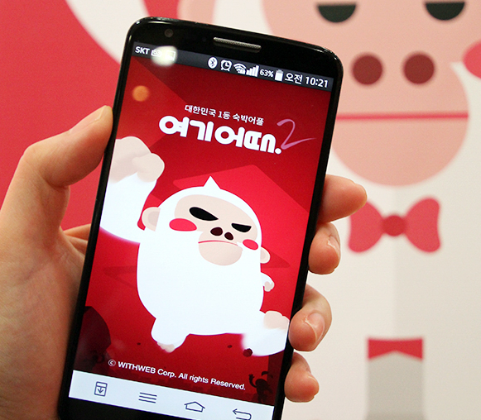
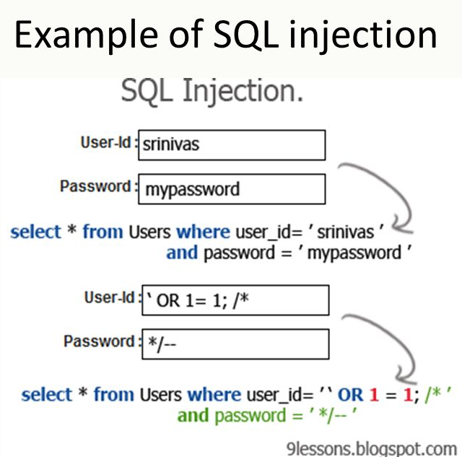

Slide 14
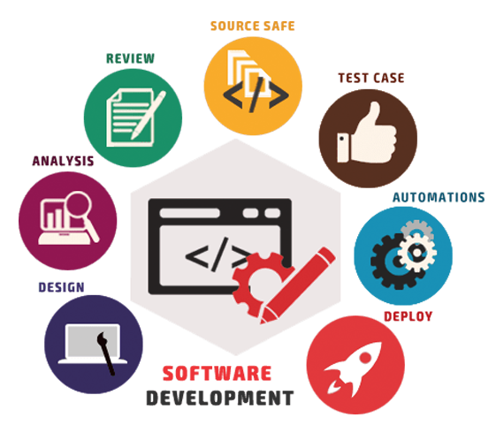
Software Engineering
Find principles of software developments, either in computer-side or in human-side
Find systematic/scientific ways to manage complexities in software developments

Slide 15
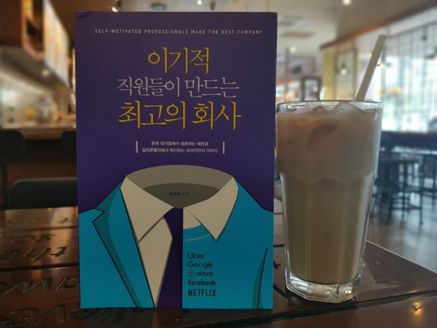

Slide 16
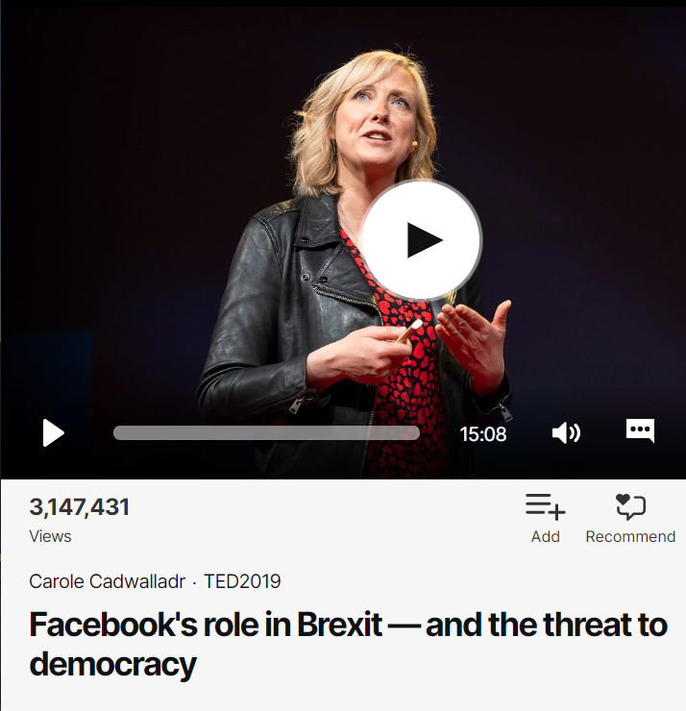
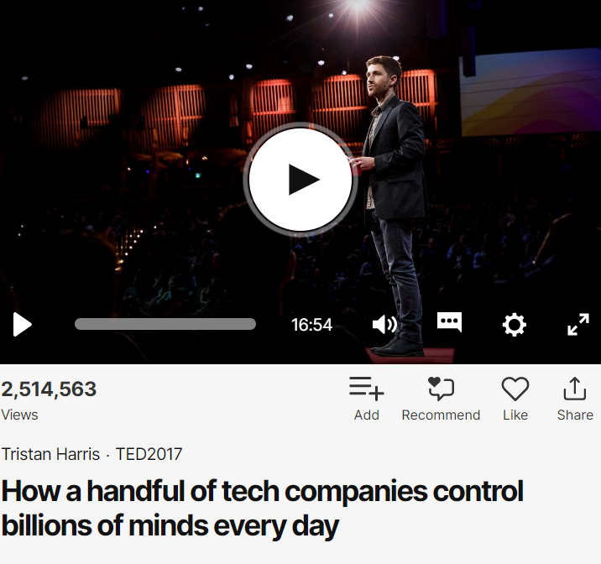

Slide 17
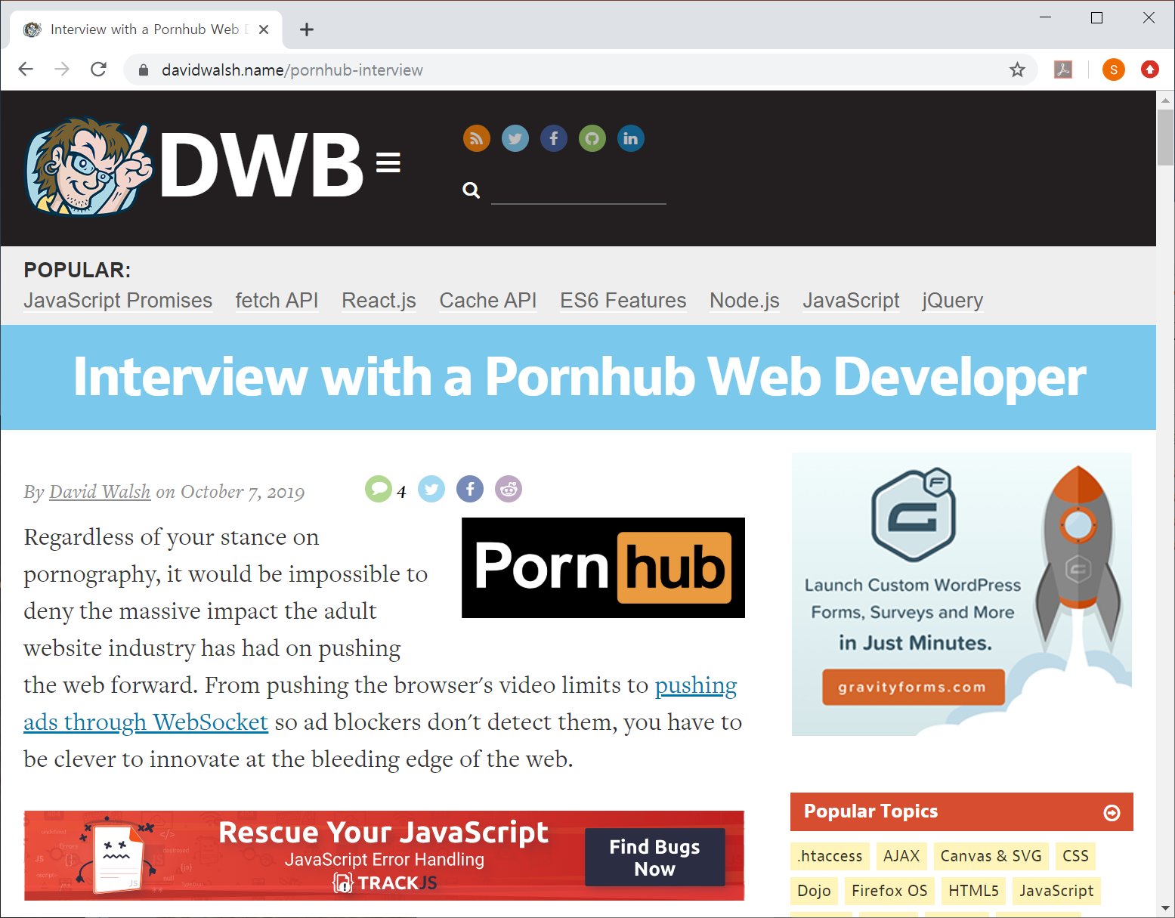

Slide 19

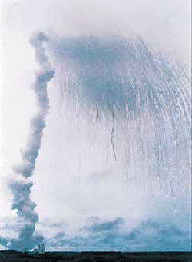
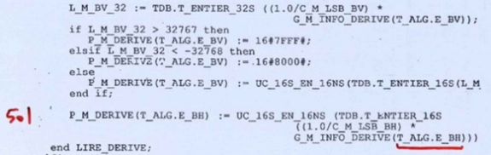
https://www.viva64.com/en/b/0426/

Slide 20



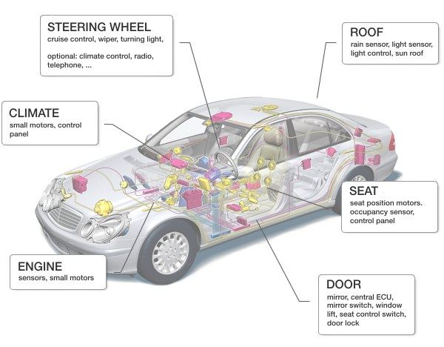

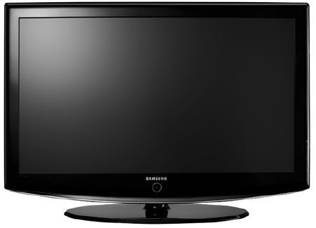
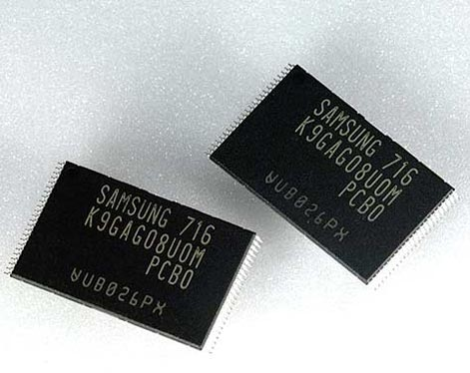


Challenge in Software Quality Assurance
Time-to-Market?
SW Quality?
Notes:
[Transition]
There are many programs where conventional testing methods are not effective at checking correctness. The case that I had particular interest is “concurrent programs”.

Slide 21
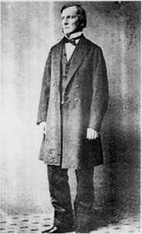
George Boole
Formulate a calculus of reasoning
Claim that logic should be considered as a branch of math, rather than a part of philosophy
Argue that there are math laws to express the operation of human mind
Showed that Aristotle's syllogistic logic could be rendered as algebraic equitation
A Brief History of Computing by G. O’Regan
George Boole (1815--1864)

Slide 22
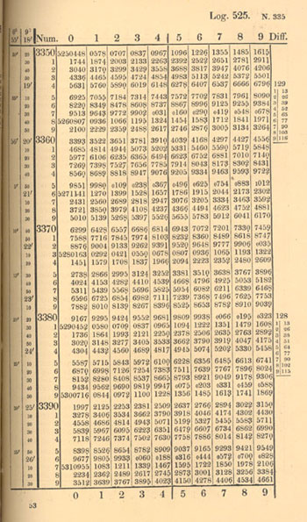
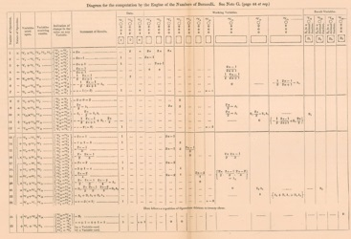
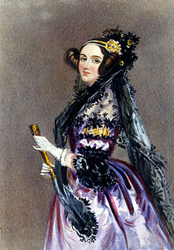
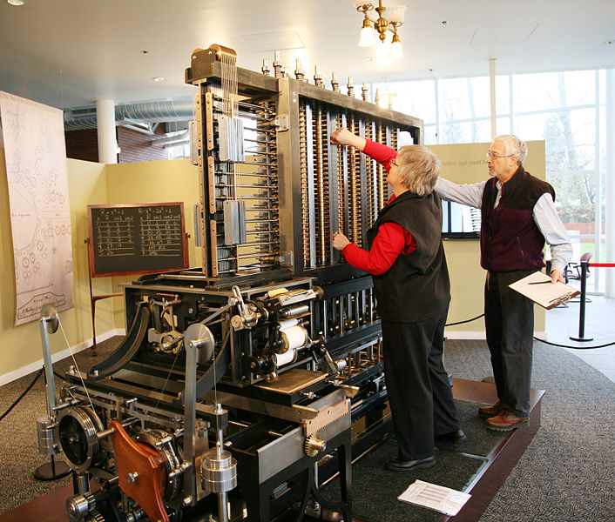
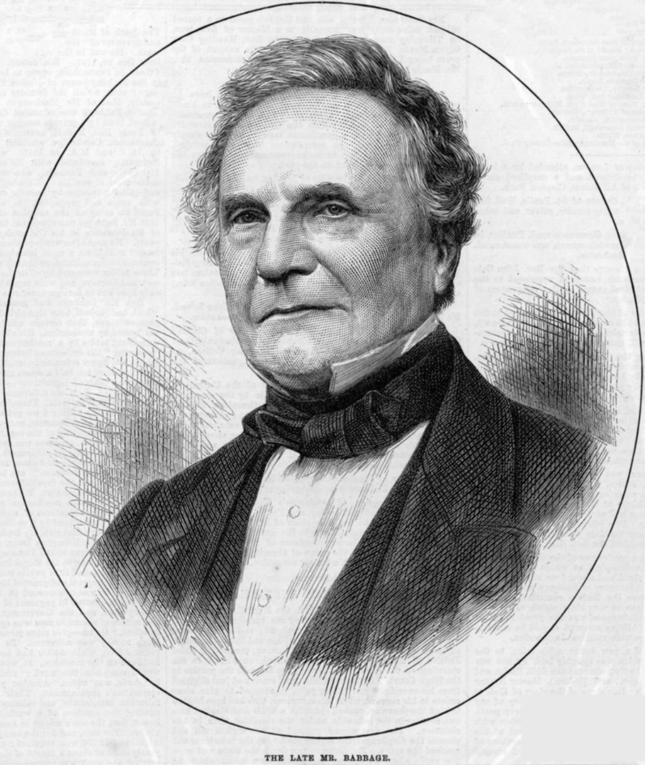
Charles Babbage
Develop mechanical methods to perform calculation
Difference engines
Propose a concept of computer
Analytic engine
Charles Babbage (1791—1871)

Slide 23
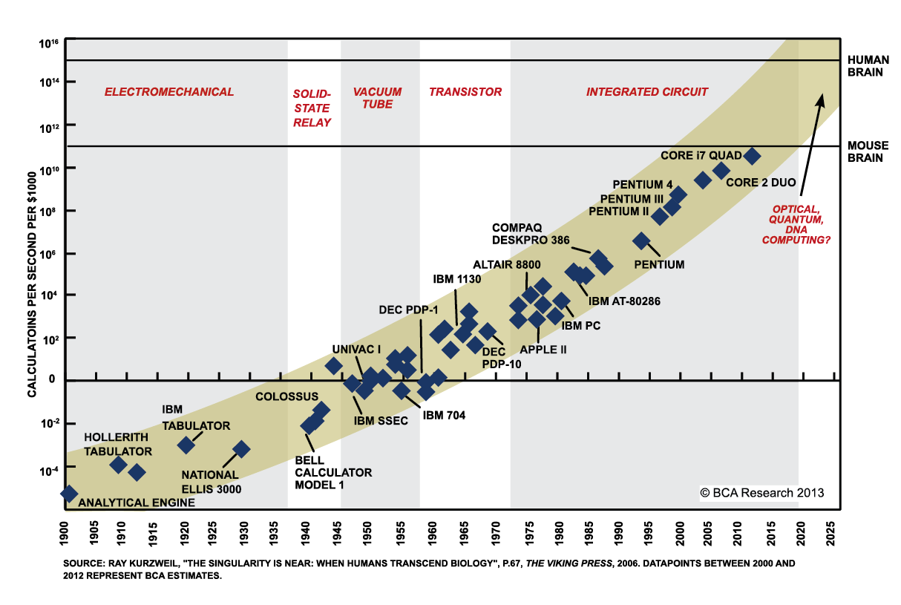

Slide 24

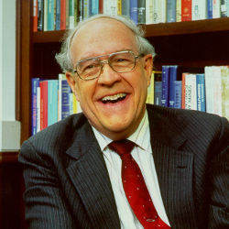

Slide 25
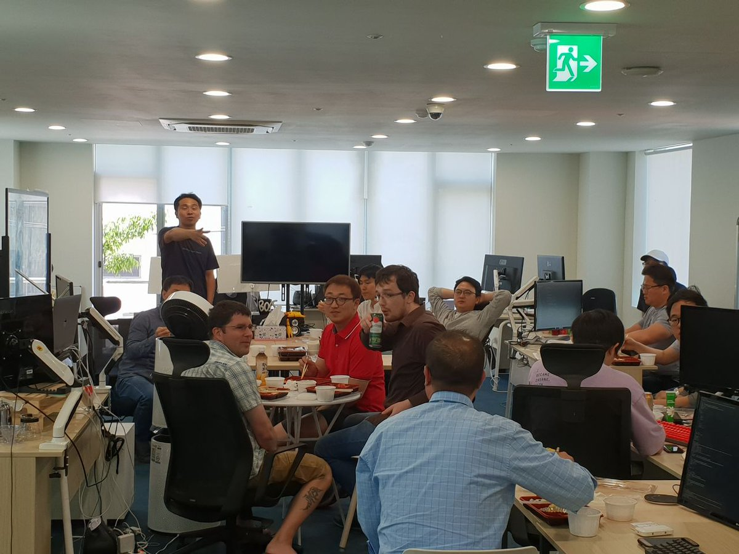
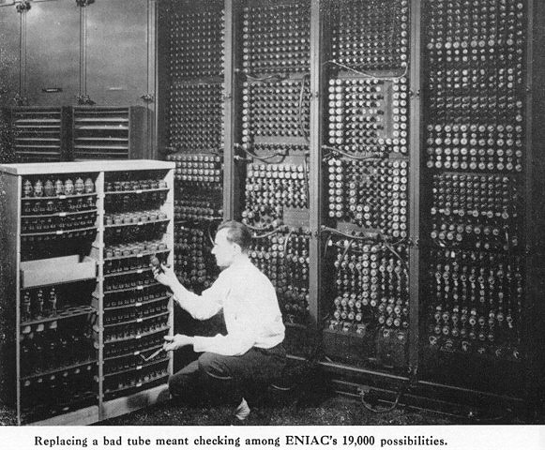


Slide 26
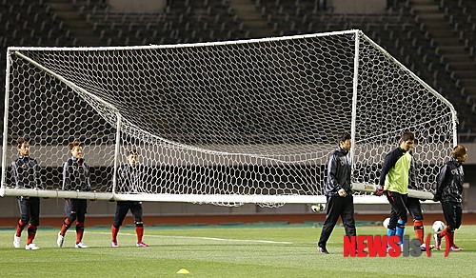
Why Software Development is Difficult?

Slide 27

Why Software Development is Difficult?

Slide 28
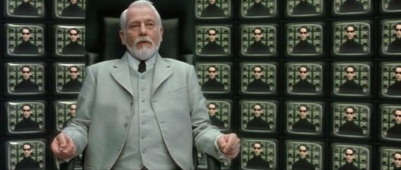
Why Software Development is Difficult?

